Slide 1


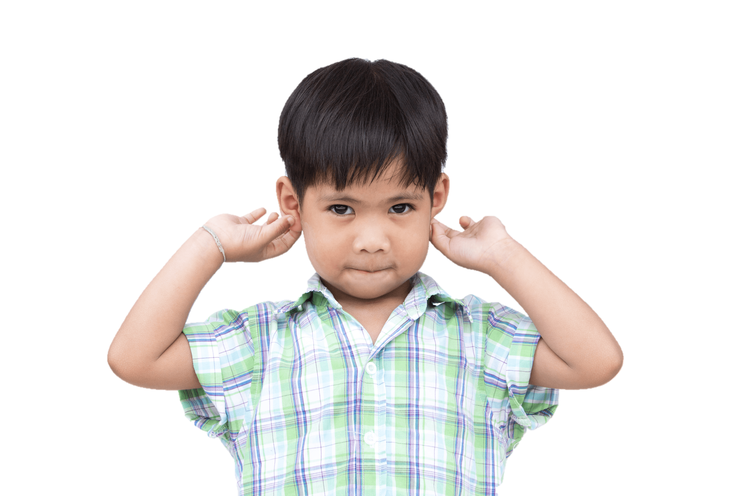


4
Our bodies
LESSON 1
Activity 4-6

Slide 2
Contents
1
3
Warm-up and review
2
4
Listen and tick.
Fun corner and wrap-up
Look, complete and read.
Let’s sing.
5

Slide 3
1
Warm-up and review
Notes:
Game “Who is faster?”
- Divide the class into 2 big groups: Boys and Girls
- Have two pupils stand back to back. Give them each a different flashcard to hold facing out and away from them.
- When teacher says “Go”, they walk three steps forward, turn to face each other then read out loud the word on the other pupil’s card.
- The faster ones will get a point.

Slide 4


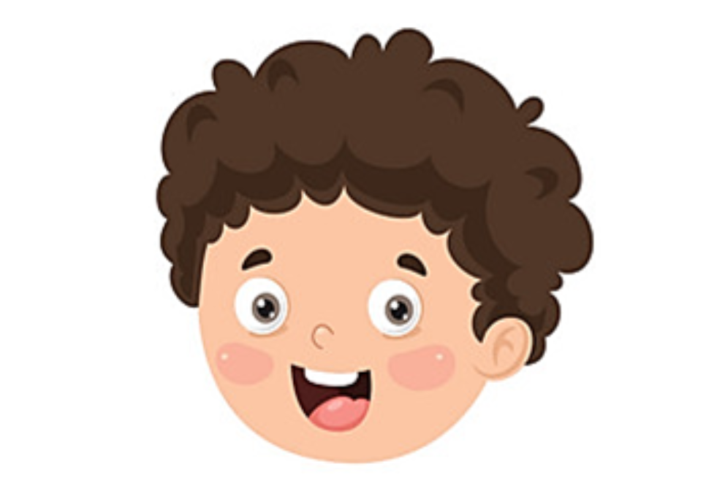


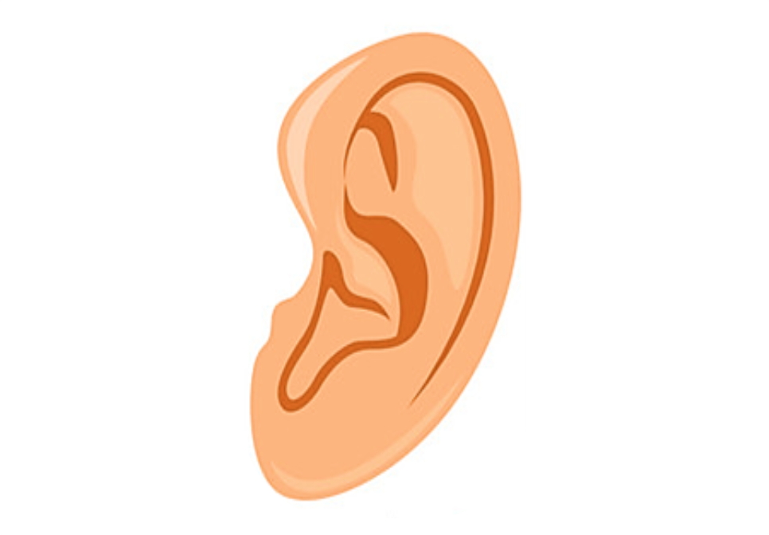


1
2
3
4
5
Notes:
- Click on any body parts to show it. Then click the arrow to go back.

Slide 5

eye

Slide 6
ear

Slide 7
hand

Slide 8
nose

Slide 9
face

Slide 10
2
Listen and tick.

Slide 11
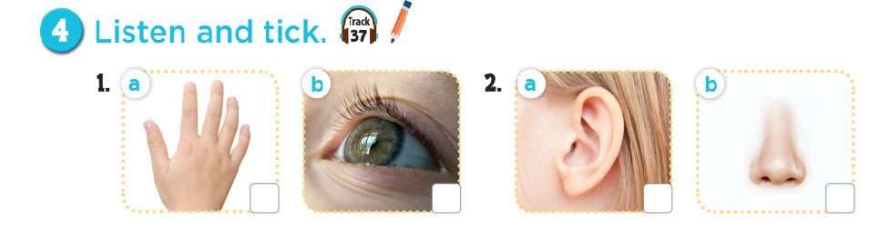

Notes:
1. A: What’s this?
B: It’s a hand.
2. A: What’s this?
B: It’s an ear.

Slide 12
3
Look, complete and read.

Slide 13
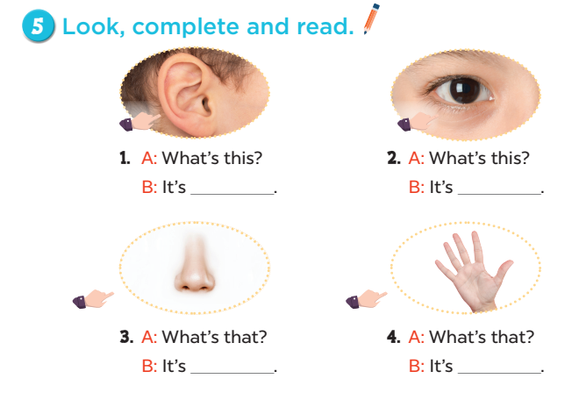
an ear
an eye
a nose
a hand
Notes:
Answers:
1. an ear
2. an eye
3. a nose
4. a hand

Slide 14
4
Let’s sing.

Slide 15
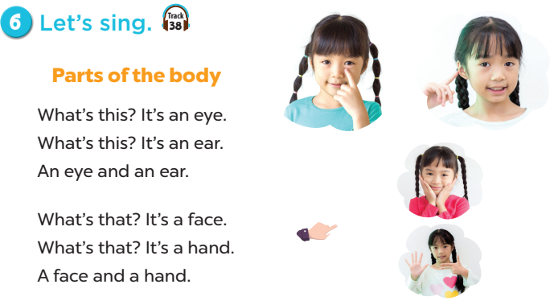


Slide 16
5
Fun corner and wrap-up

Slide 17



5
20
Lucky Wheel
15
40
30
25
50
10
SPIN
Notes:
Game: Lucky wheel
- Divide the class into groups.
- Each group has a pupil to spin the wheel. Click the “Spin” button and let it spin until a pupil says “Stop!”.
- Click on the wheel to make it stop.
- Click the red arrow to transfer to the pictures slide.
- Their group will get points when he/ she answers the question correctly.

Slide 18
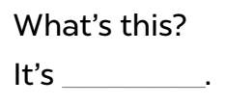
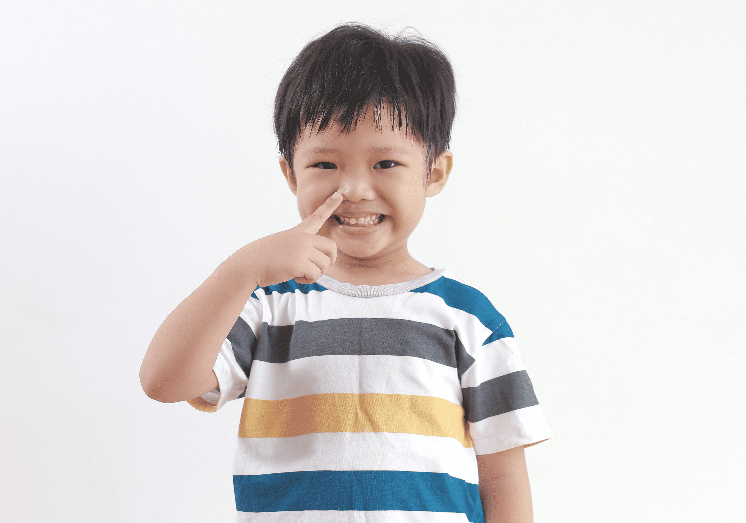
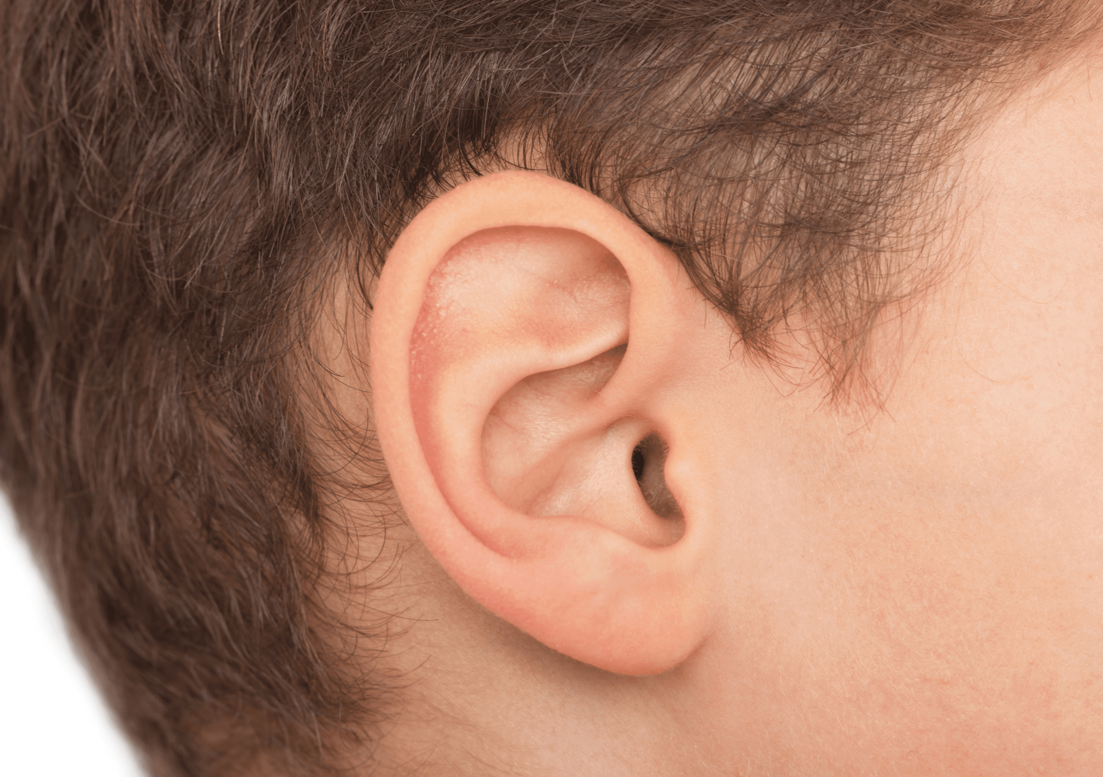

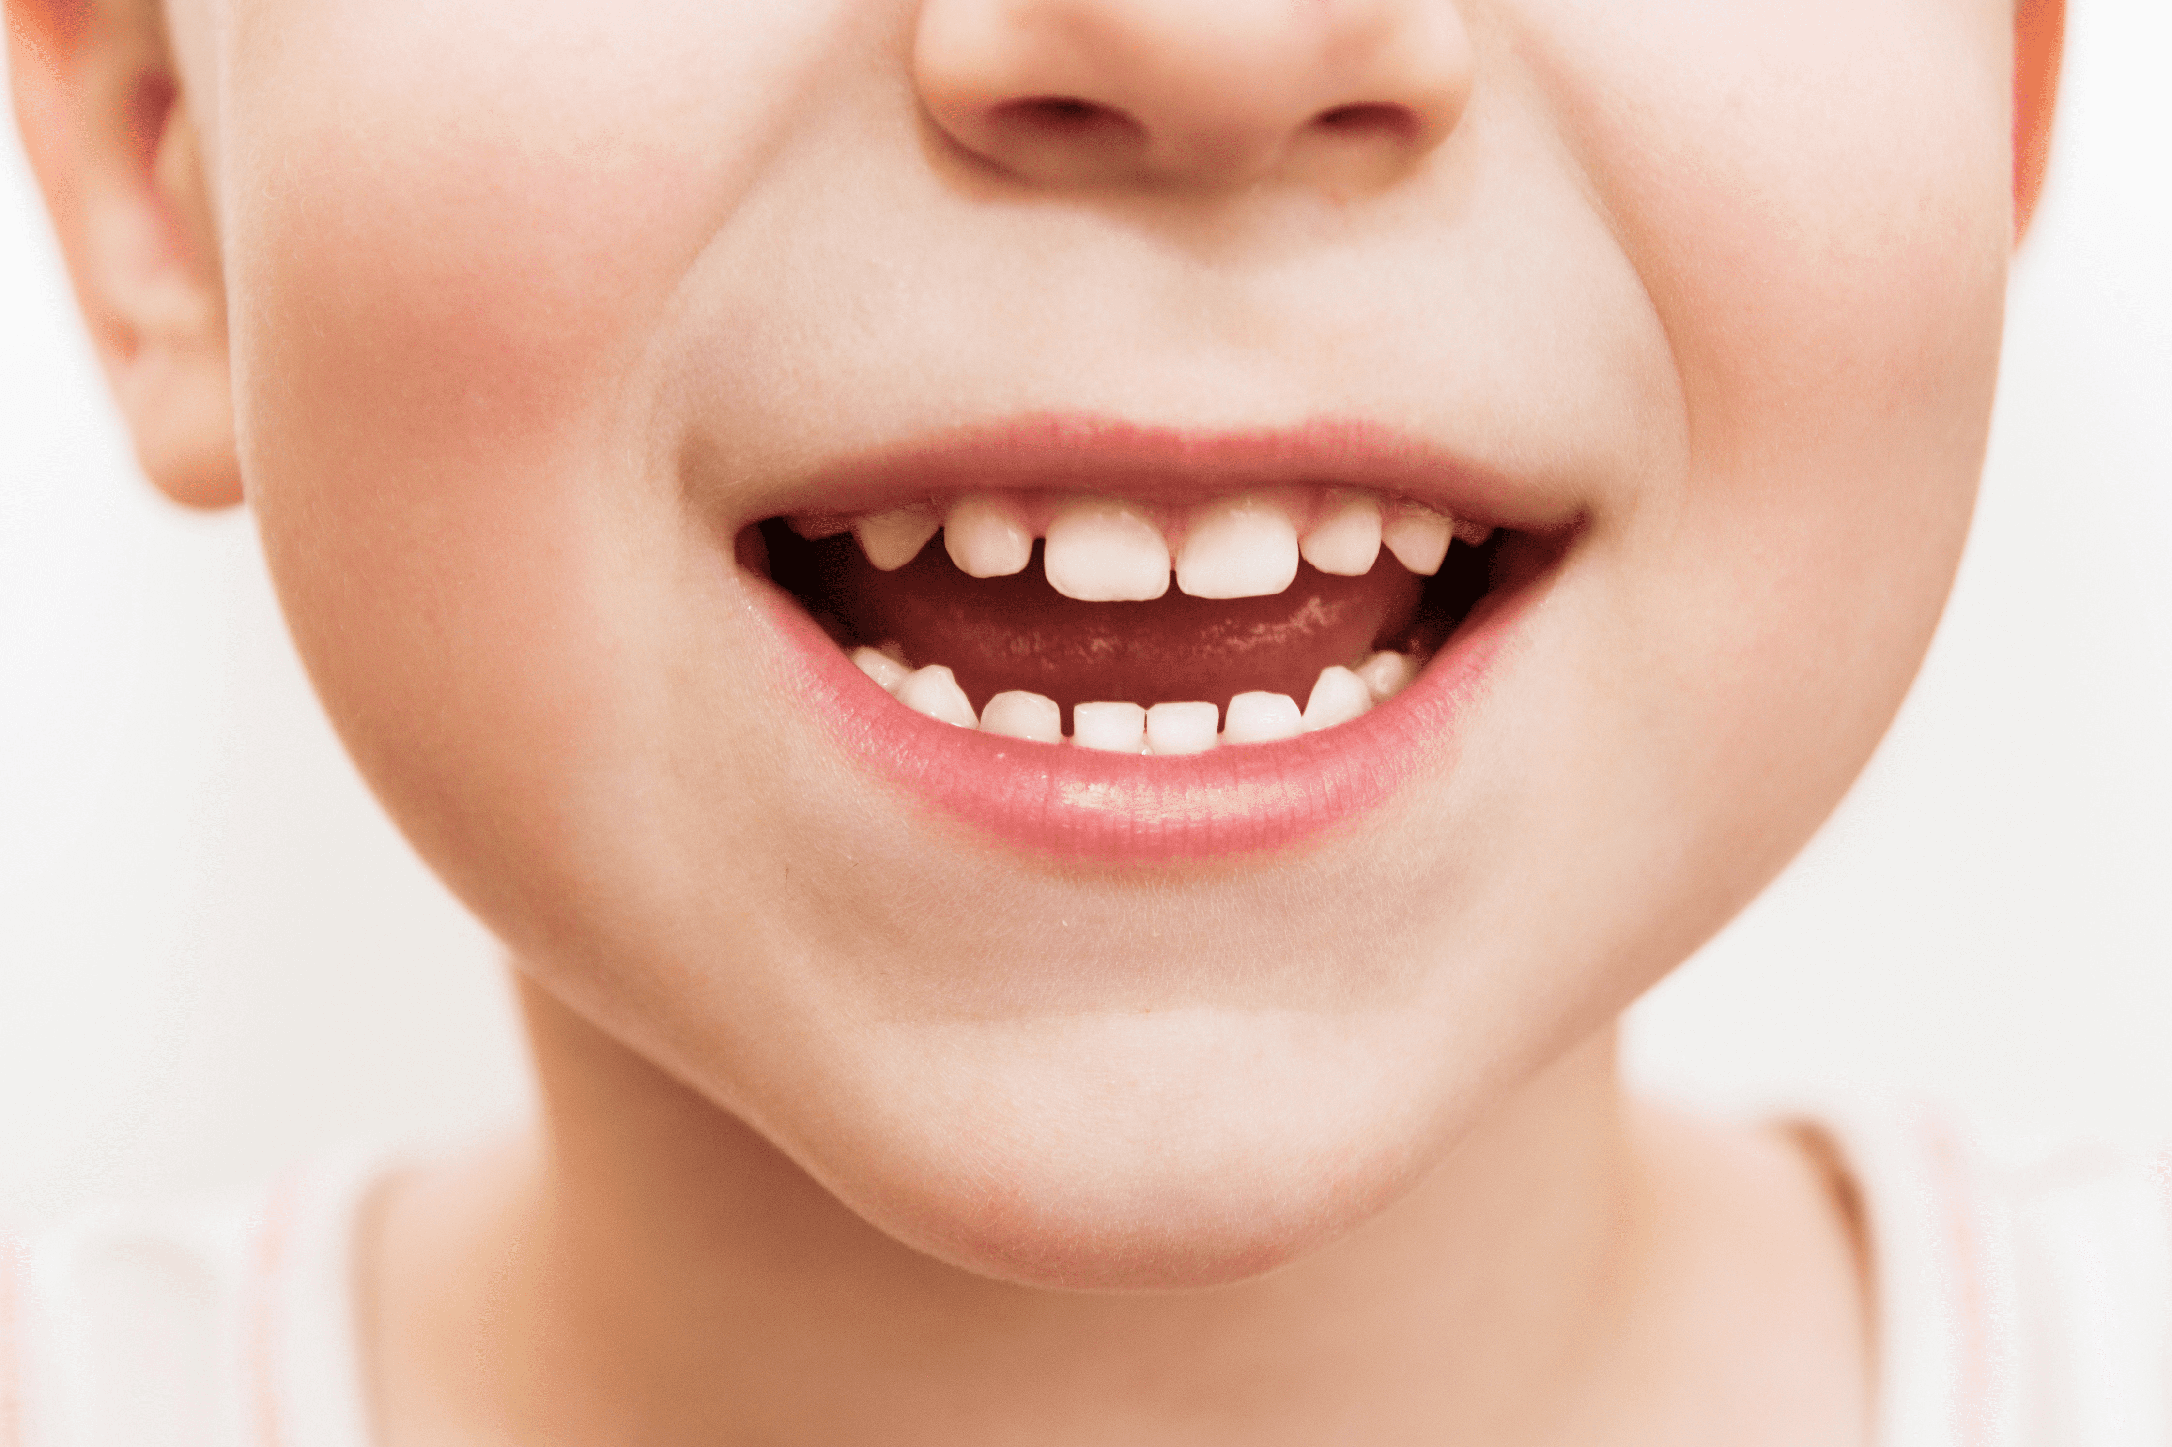
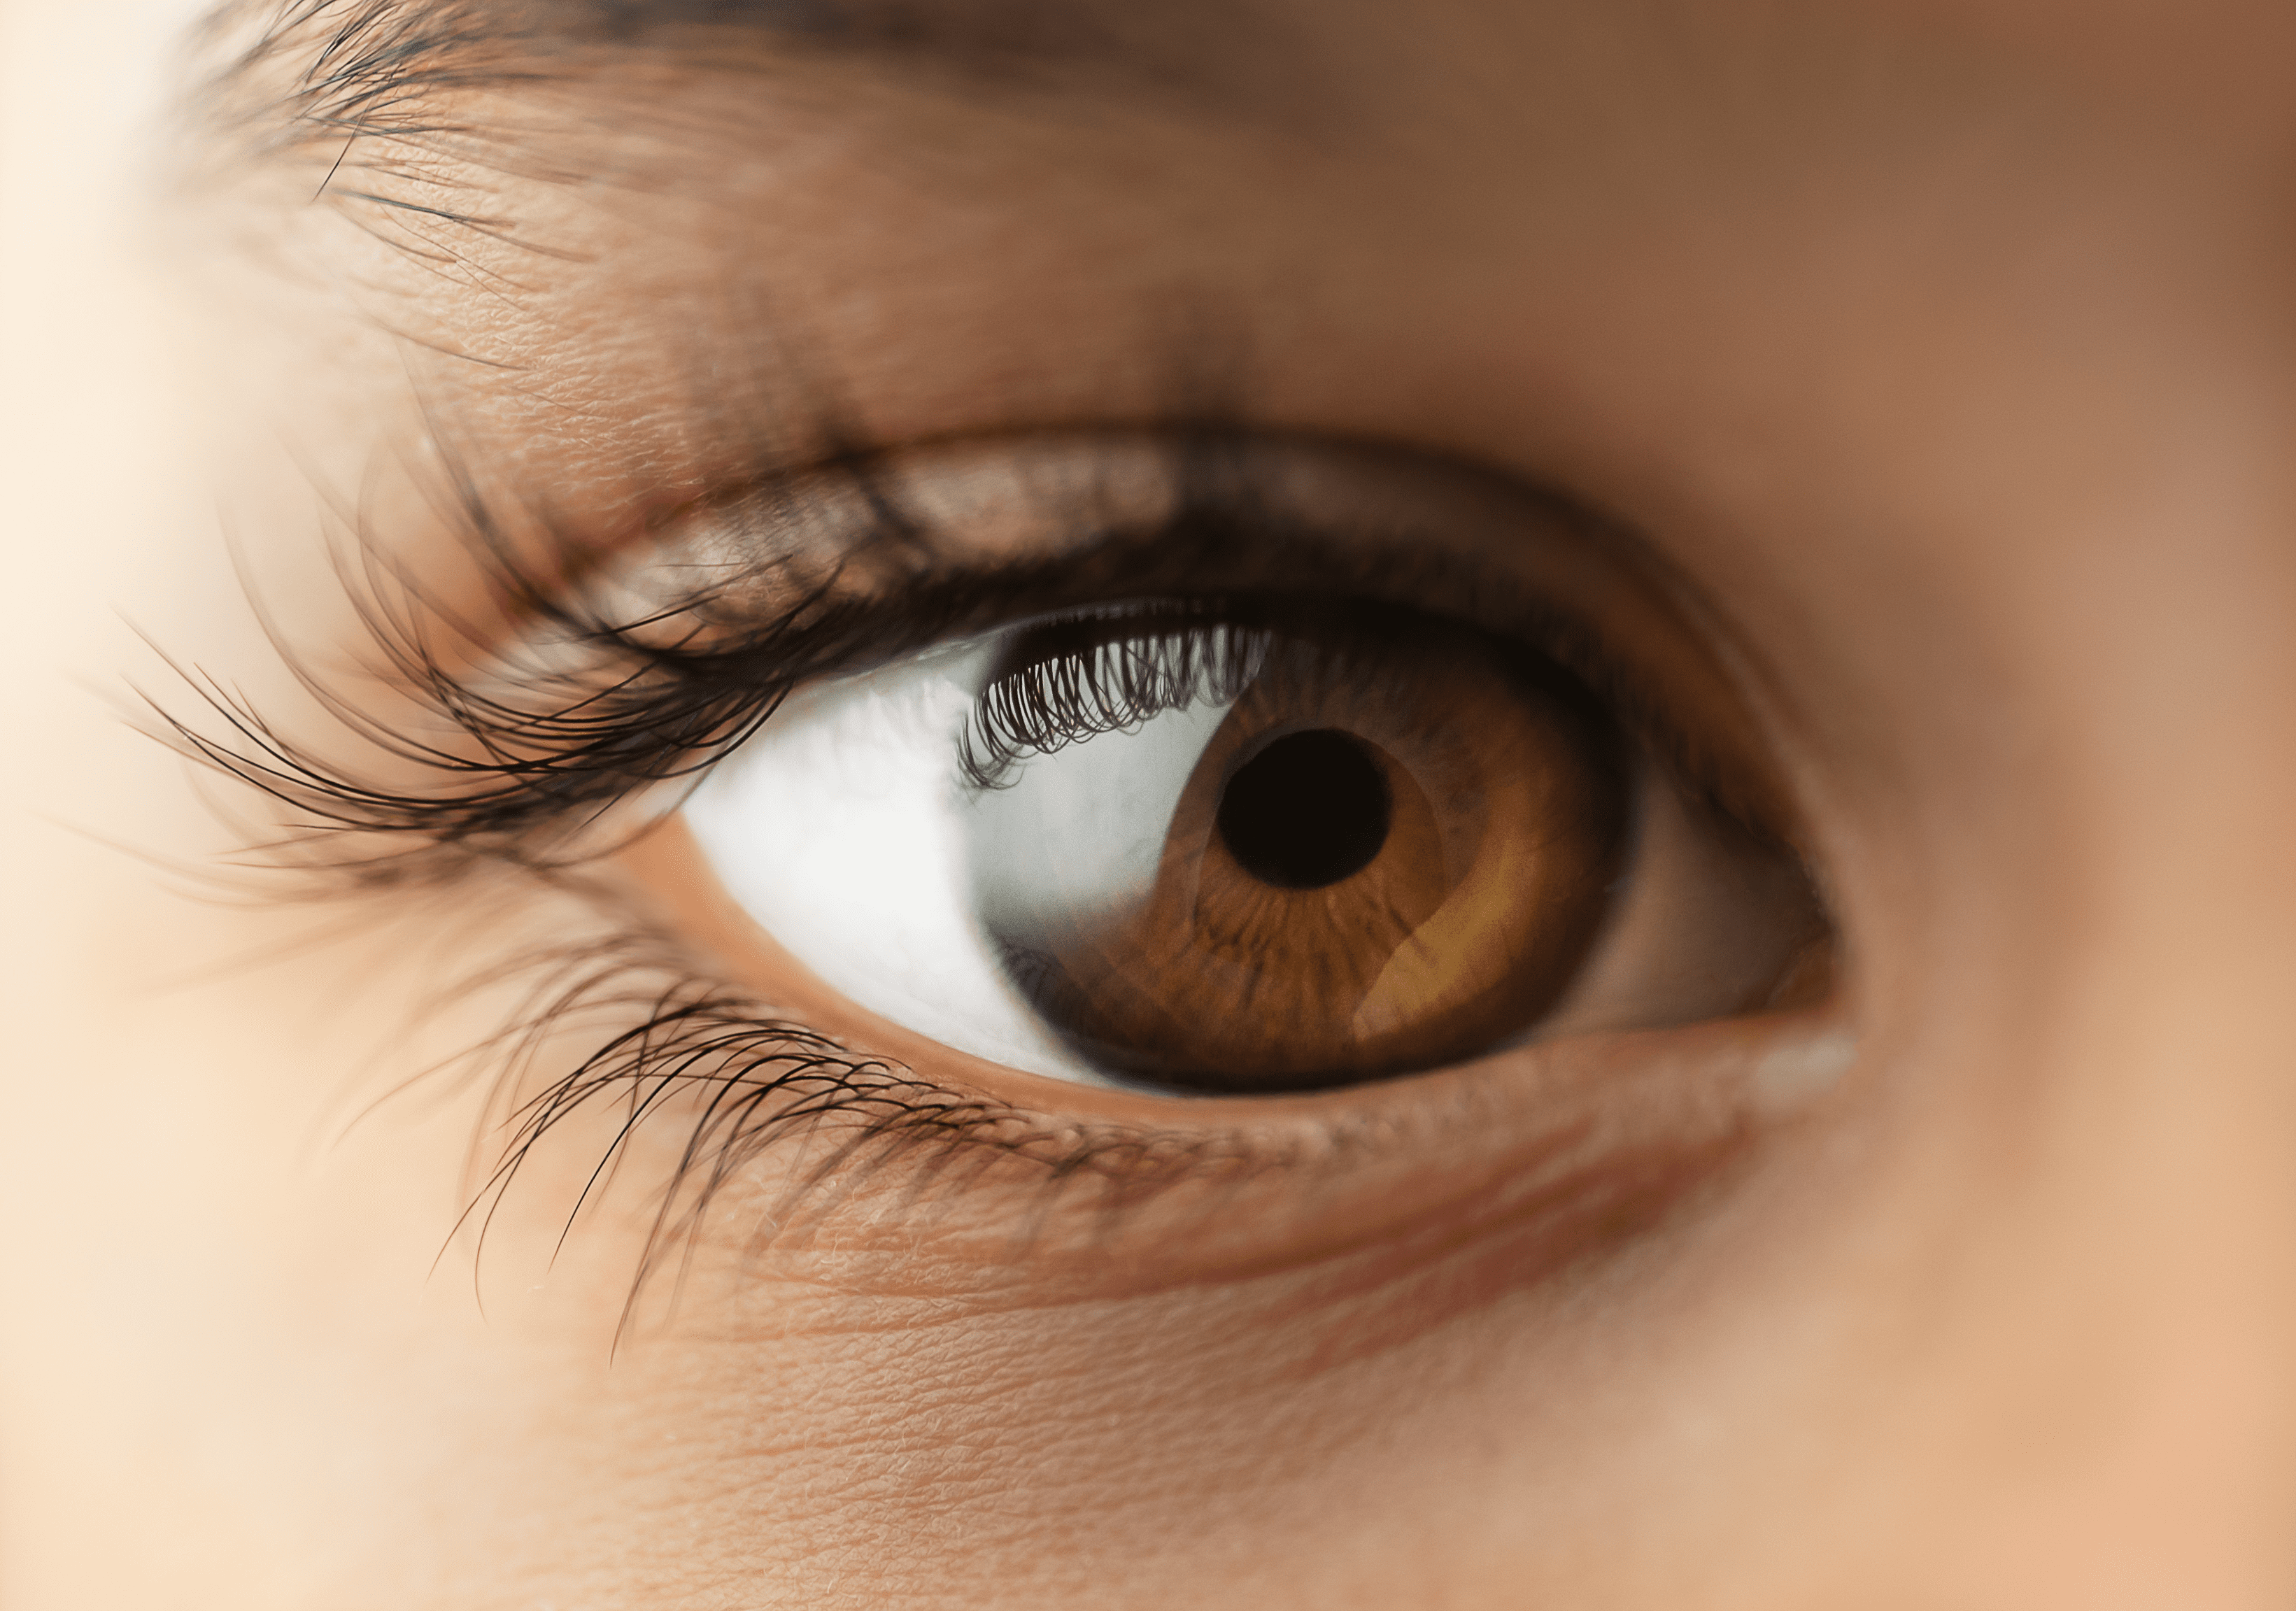
Notes:
- Click on the red arrow to go back to the wheel.

